Slide 1
MOST POPULAR COMPONENTS
SUDHARSAN K

Slide 2
LIST OF COMPONENTS
DATA GRID
CHARTS
LISTVIEWER
SCHEDULER
DIAGRAM
PDF VIEWER
EXCEL LIBRARY

Slide 3
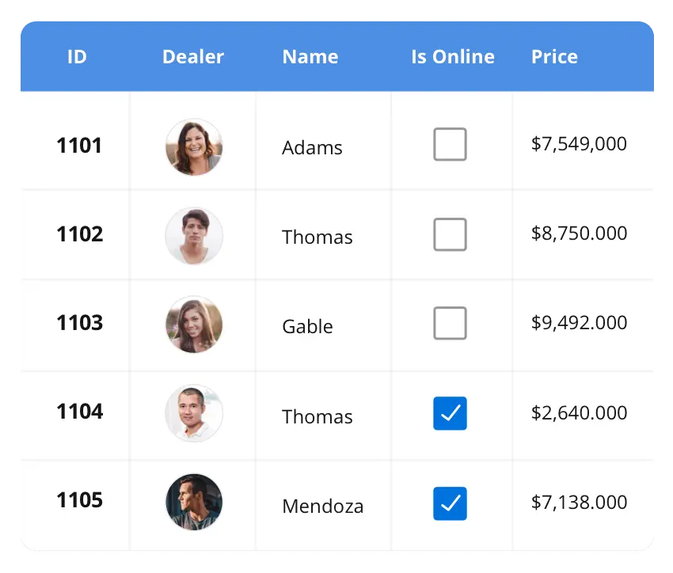



DataGrid
The DataGrid control is a high-performance grid component that helps display and manipulate large amount of data in a tabular format. Its rich feature set includes functionalities like data binding, sorting, grouping, editing, filtering, swiping, dragging, resizing, loading more items, pull-to-refresh and exporting to Excel and PDF file formats.
SUPPORTED PLATFORMS
JavaScript Angular React VUE Blazaor
Flutter jQuery ASP.NET MVC ASP.NET Core
ASP.NET Webforms
WinForms WVF WinUI Flutter Xamarin UWP
Xamarin Flutter UWP

Slide 4
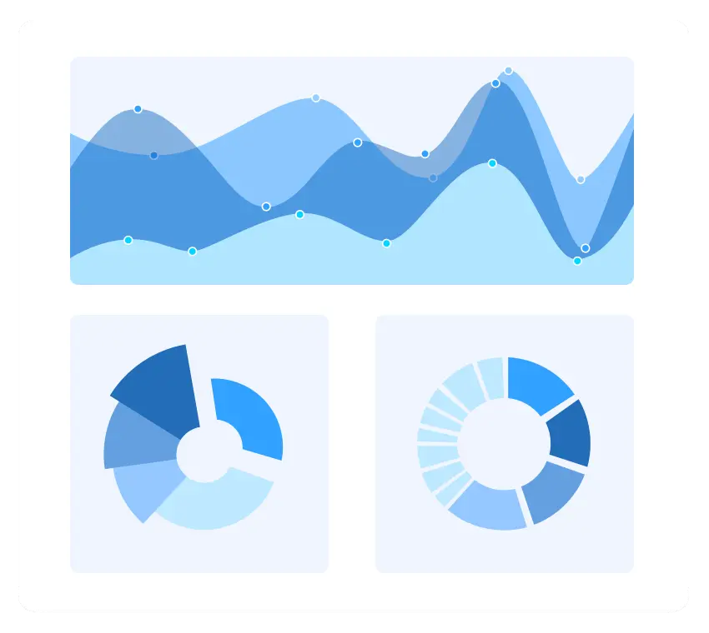
CHARTS
The charts can plot a wide range of chart types, ranging from line charts to specialized financial charts. Its rich feature set includes functionalities like data binding, multiple axes, legends, animation data labels, annotations, trackballs, tooltips and zooming
SUPPORTED PLATFORMS
JavaScript Angular React VUE Blazaor
Flutter jQuery ASP.NET MVC ASP.NET Core
ASP.NET Webforms
WinForms WVF WinUI Flutter Xamarin UWP
Xamarin Flutter UWP

Slide 5
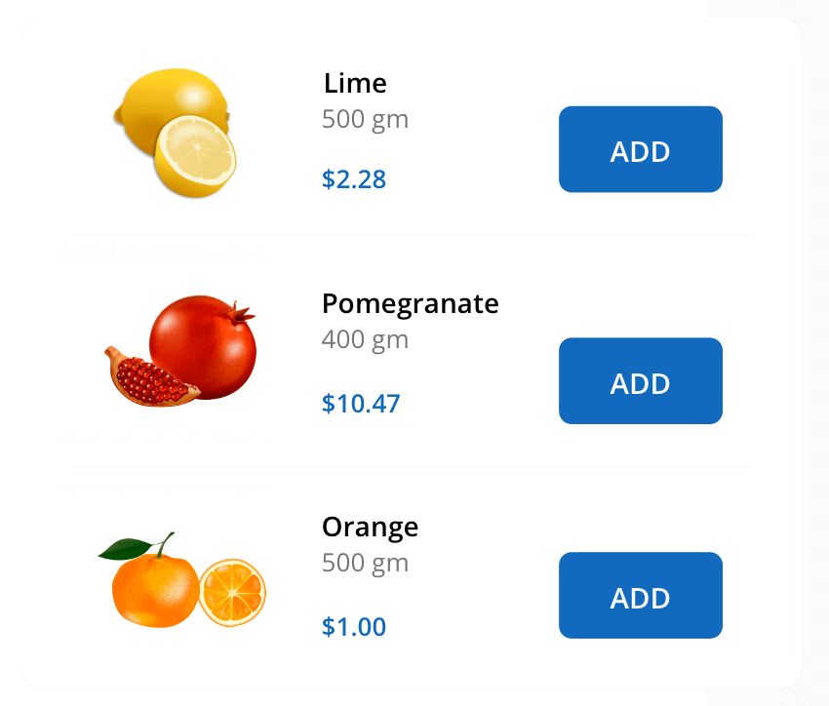
ListView
The listView vendors a set of data items with UI views or custom templates. It has many features like grouping, sorting, filtering, paging, swiping, multiple selection, drag and drop, and different layout types. The ListView control has been optimized to work with large amounts of data.
SUPPORTED PLATFORMS
JavaScript Angular React VUE Blazor jQuery ASP.NET MVC ASP.NET CORE
WinForms WVF WinUI Flutter Xamarin UWP
Xamarin Flutter UWP

Slide 6
The listView vendors a set of data items with UI views or custom templates. It has many features like grouping, sorting, filtering, paging, swiping, multiple selection, drag and drop, and different layout types. The ListView control has been optimized to work with large amounts of data.

